Slide 1
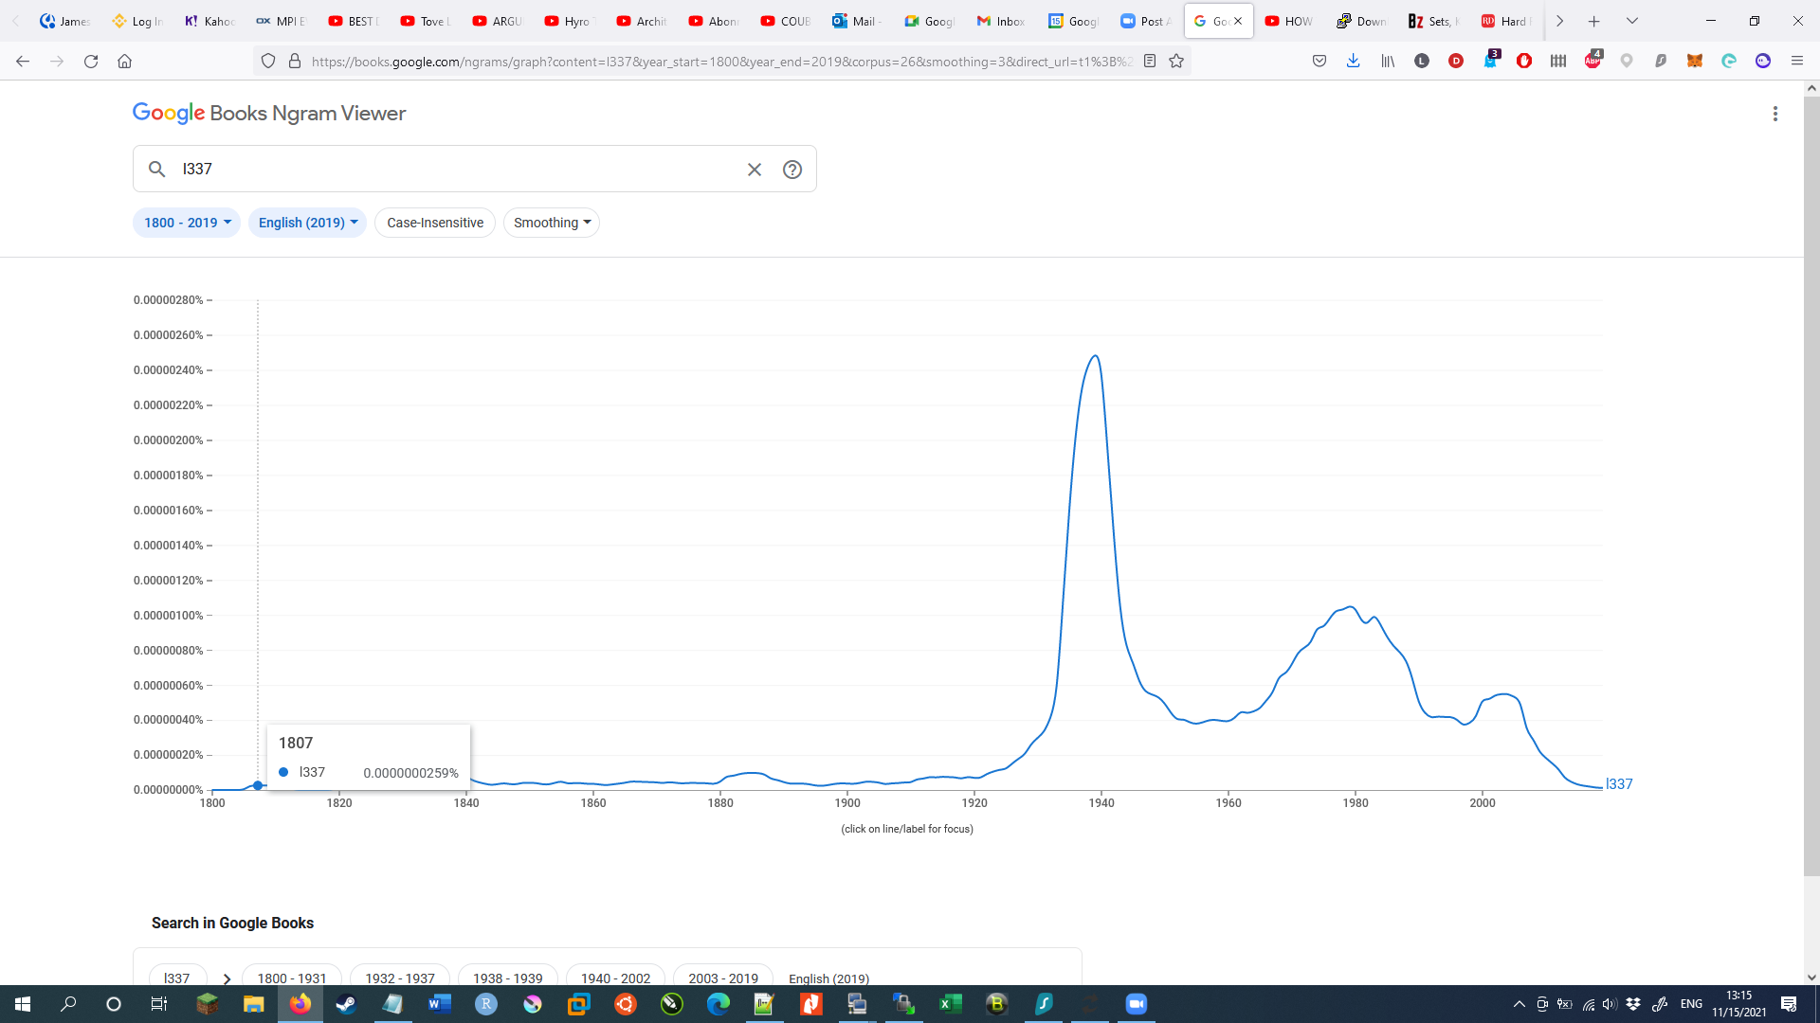
Elite (l337 = leet) coders tutorial 101

Slide 2


Goal of this session:
Getting y’all familiar with Linux
Give y’all a jump-off point to get into bioinfo
Hopefully get you excited to do data analysis
Prevent y’all from destroying the cluster
and asking me to fix it :P

Slide 3




Before this session
During this session
After we’re done

Slide 4

What we need
VPN
PuTTY / Kitty (ssh software)
What we’ll hopefully get out of this first (2nd) session
Basic file handling
Understanding on how to manipulate files
Learn how to NOT delete the entire cluster :P

Slide 5
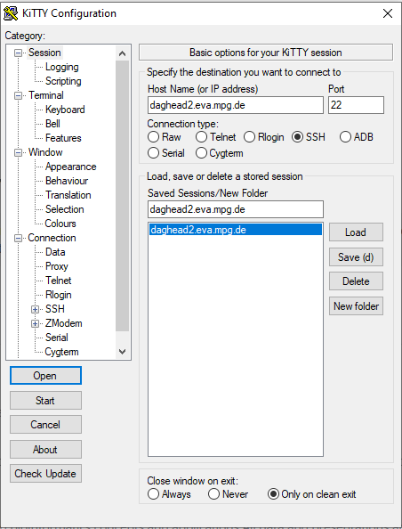
In windows you can download Putty/Kitty
Log into the server by filling in the host name and port
You can give this setting a name and save it too for convenience
On ubuntu/Mac you can also open a terminal (in the software menu). Click the terminal and type ssh daghead2.eva.mpg.de For this to work, make sure you have your VPN connected. If you haven’t set up the VPN yet, contact the IT admin

Slide 6
Type the following into your “session” on the terminal. Make sure you are actually connected cd /mnt/scratch/basic_linux/TEST_AREA
cd, short for change directory, now changed your directory to TEST_AREA
Here you can play without too much stress… just refrain from using commands that haven’t been mentioned yet until
you understand what they do.
Text we type to the screen is also sometimes refered to as STDin, not to be confused with the funky mushrooms that might grow after a session of the horizontal tango, but it stands for ‘STanDard Input’, or maybe ‘STandarD input’.
One thing we can now do is make a directory for you to play in, a personal “folder” in which you can make, change and delete files without feeling too worried. Type in the following into your “session” on the terminal to accomplish this. Just change the portion that says [your_username] to whatever you want to call this folder.
mkdir -p /mnt/scratch/basic_linux/TEST_AREA/[your_username]
and
cd /mnt/scratch/basic_linux/TEST_AREA/[your_username]

Slide 7
You are now in your newly formed folder. You can check this by typing pwd in your “session”, it’s short for path of working directory
pwd
This command gives you back a line of text that tells you in which folder you are
If it’s not the same with the folder you made during the last slide, just revisit that slide and try again.
Now that we have our own little area to play, we can experiment with tools/software
Software or sometimes called tools, normally need two things, it needs to know what to work on, and it sometimes needs to
know what type of output you want. The input for the ‘mkdir’ tool was a piece of text we typed in that told it what directory to make, it automatically knows that the output is a new directory. Another tool we tried was ‘cd’ which used as input the text you typed that specified which folder to go to, the output is that it changes the location you are currently browsing to a new location.
We’ll now go over some basic tools to navigate your surroundings in Linux. These tools off course need some input to know what to work on. You can use the handy -h/--help options to see what the exact input and output of tools are.

Slide 8
mkdir # make a directory
Getting basic meta information from files
ls # list files/folders
ls -lh # Show all the metadata of files such as size and read/write/execute permissions
ln # make a link to file/folder
pwd # Path to Working Directory
basename # Gives the absolute file name. without directory
dirname # Gives the absolute directory name for file, without filename
readlink –e # full pathname
cd # change directory
If stuck, ask 4 help!
Your_software -h / --help # almost all tools come with a help list with the available commands and how to use them
mkdir --help
ls --help
sed –help
etc…

Slide 9
File lookup and assessments:
find # find a file in a location or multiple locations
touch # this creates an empty file, will have it's uses later
nano # a file editor, can be used to quickly edit files
less # a on-the-fly way of showing the content of a file
echo # Can be used to put text to STDout
Destructive file commands
cp # copy files, directories need to be done recursive
mv # move files or change it's name, directories need to be done recursively
rm # remove a file, directories need to be done recursively

Slide 10
File manipulations:
cat # concatenate files, can also be used to put file content onto STDout
zcat # the zipped equivalent of cat
head # take the top lines from a file
tail # take the bottom lines from a file
cut # you can split lines in sections, good for column extractions
split # break up a file into sub files
| # a pipe, this will put the STDout from the first command into the STDin
for the next command
Character lookups and replacements
grep # search for a work/character/regex in a file
grep 'string_search' file.txt
sed # replace one or all word/character/regex in a file
sed 's/string_search/string_replace/g' file.txt

Slide 11
Storing data into files:
> # directing output from a tool to a different new file than the screen
>> # adding output from a tool to a different existing file than the screen
1> # STDout
2> # STDerr
&> # STDout + STDerr (all output)

Slide 12

What’s next?
Next session
Understanding your environment
Working with Qsub
Bash
Getting familiar with GitHub and Conda
Local installation of tools
Session after:
EAGER2
HOPS

